Slide 1

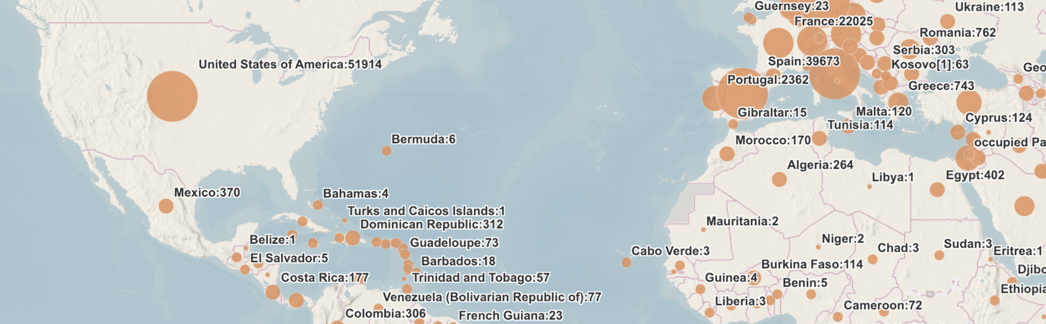
Scientific Citizen
Scientific Citizen
Home Local World Latest Subscribe About Us
An Update on COVID-19 in the United States
Author: Richard Owens
Published March 27, 2020
The number of confirmed cases of the novel coronavirus has increased dramatically in the United States during the past two weeks. Many state governments and private businesses are taking precautionary measures to slow the spread of the disease. Some of these measures include cancelling large events such as music festivals, sporting events, and parades, as well as closing public K-12 schools and Universities.
The first case of coronavirus was reported on December 31, 2019 in Wuhan, China, since then there has been rapid growth in the number of cases, with nearly every country being affected by the virus. The first case of COVID-19 in the United States was reported on January 21, 2020. By February 29th there were 68 cases and 1 death, by March 6th there were 319 cases and 15 deaths, by March 13th there were 2,183 cases and 48 deaths, and by March 20th there were 19,367 cases and 255 deaths. As of March 27th there are 96,968 confirmed cases and 1,477 deaths from the disease in the United States alone.
Government officials hope that encouraging citizens to take preventative measures, such as frequent hand washing and limiting close contact, will reduce the spread of the disease.
Notes:
Sample bias article #2

Slide 2
Scientific Citizen
Scientific Citizen
Home Local World Latest Subscribe About Us
An Update on COVID-19 in the United States
Author: Richard Owens
Published March 27, 2020
The number of confirmed cases of the novel coronavirus has increased dramatically in the United States during the past two weeks. Many state governments and private businesses are taking precautionary measures to slow the spread of the disease. Some of these measures include cancelling large events such as music festivals, sporting events, and parades, as well as closing public K-12 schools and Universities.
The first case of coronavirus was reported on December 31, 2019 in Wuhan, China, since then there has been rapid growth in the number of cases, with nearly every country being affected by the virus. The table below shows the growth of cases in the U.S.
The first case of COVID-19 in the United States was reported on January 21, 2020. Since the first confirmed case in the United States, the number of cases has changed dramatically, especially in densely populated areas such as New York, New Jersey, California, and Washington. Many states are doing their part to “flatten the curve” by enforcing curfews on residents and closing sit-in restaurants and bars.
Government officials hope that encouraging citizens to take preventative measures, such as frequent hand washing and limiting close contact, will reduce the spread of the disease.
United States COVID-19 Data
Date | Confirmed Cases | Deaths
Feb 29 | 68 | 1
Mar 6 | 319 | 15
Mar 13 | 2183 | 48
Mar 20 | 19,367 | 255
Mar 27 | 96,968 | 1,477
Notes:
Sample bias article #2

Slide 3
Scientific Citizen
Scientific Citizen
Home Local World Latest Subscribe About Us
An Update on COVID-19 in the United States
Author: Richard Owens
Published March 27, 2020
The number of confirmed cases of the novel coronavirus has increased dramatically in the United States during the past two weeks. Many state governments and private businesses are taking precautionary measures to slow the spread of the disease. Some of these measures include cancelling large events such as music festivals, sporting events, and parades, as well as closing public K-12 schools and Universities.
The first case of coronavirus was reported on December 31, 2019 in Wuhan, China, since then there has been rapid growth in the number of cases, with nearly every country being affected by the virus. The graphs below show the growth of cases in the U.S.
The first case of COVID-19 in the United States was reported on January 21, 2020. Since the first confirmed case in the United States, the number of cases has changed dramatically, especially in densely populated areas such as New York, New Jersey, California, and Washington. Many states are doing their part to “flatten the curve” by enforcing curfews on residents and closing sit-in restaurants and bars.
Government officials hope that encouraging citizens to take preventative measures, such as frequent hand washing and limiting close contact, will reduce the spread of the disease.
Notes:
Sample bias article #2

